Slide 1
Speech vs. Writing
& Anglophone Writing Assessments
Les Perelman
Notes:
Thank you. I love being in Australia even though there are high government officials in Washington DC who insist we can’t be here because we are past the edge of the flat Earth

Slide 2
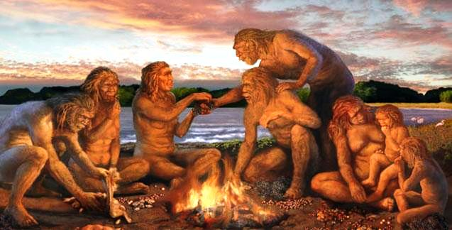
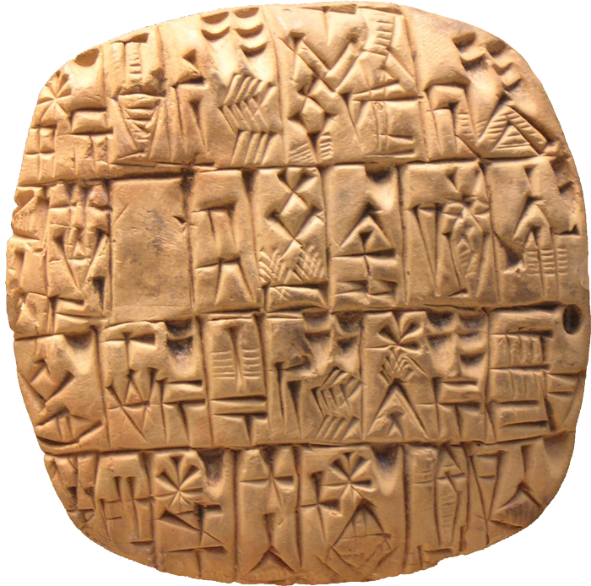
Nature
Speech
Writing
Innate human characteristic
Relatively recent technology

Slide 3
Acquisition
Speech
Reading / Writing
Exposure to language
Instruction

Slide 4
Simultaneous production & reception
Speech
Writing
Yes
No

Slide 5
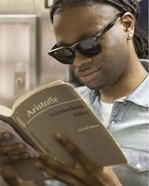
Permanence
Speech
Writing
Transitory
Relatively permanent

Slide 6
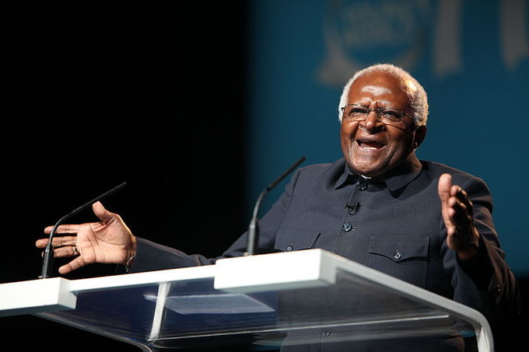
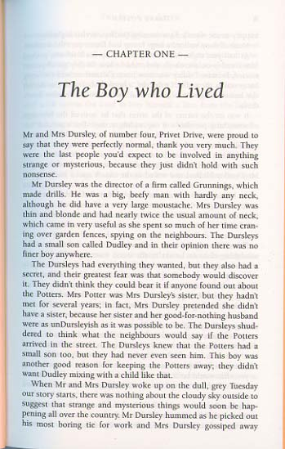
Communication channels
Speech
Writing
Multiple
Single

Slide 7
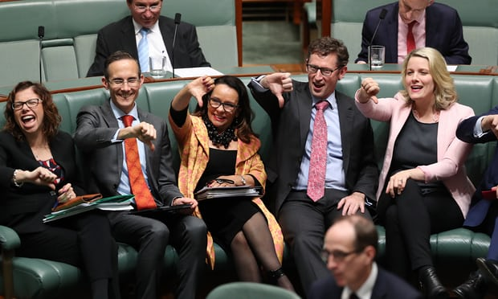
Opportunity for audience to respond to communicator
Speech
Writing
Yes
No

Slide 8
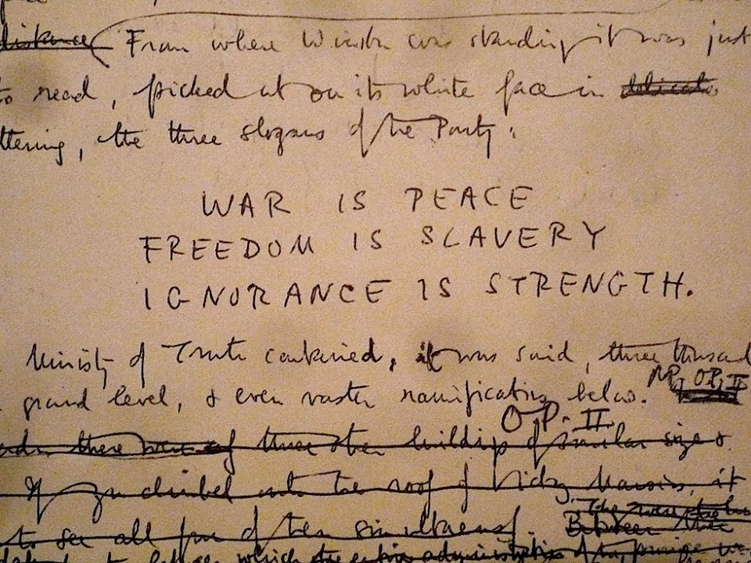
Opportunity for revision
Speech
Writing
No
Yes

Slide 9
Anglophone Tests

Slide 10
Criteria for selection
Information publicly available on web
Representative of some of the various Anglophone educational systems
Three K-12 assessments selected as performing one or more of the following functions
as an indicator of school performance for use by school administrators in improving schools and by parents in selecting schools
as a snapshot of national student achievement that can be used for longitudinal comparison
as formative feedback to students on their skills in literacy and numeracy
Three Year 12 “Leaving” Assessments that possessed one or more features of interest

Slide 11
National Assessment of Educational Progress (NAEP) The Nation’s Report Card USA
National representative sample – Grades 4, 8, & 12
Subject Areas
Mathematics
Reading
Writing
Science
Arts
Civics
Geography
United States History
Technology & Engineering Literacy

Slide 12
National Assessment of Educational Progress (NAEP) The Nation’s Report Card USA
What NAEP Does Report
subject-matter achievement by state and large urban areas
for populations of students (e.g., all fourth-graders)
groups within those populations (e.g., female students, Hispanic students).
What NAEP does not provide
scores for individual students
scores for individual schools

Slide 13
NAEP Writing Test
Two 30 minutes tests
Graded holistically
Two out of three genres
to persuade, in order to change the reader’s point of view or affect the reader’s action
to explain, in order to expand the reader’s understanding
to convey experience, real or imagined, in order to communicate individual and imagined experience to others.
Mix favors narrative in lower grades and persuasive writing in higher grades
Developed by teachers and educational experts
Students can use dictionaries

Slide 14
Smarter Balanced Assessment Consortium Smarter Balanced
20 US States members or affiliates
3 Traits for composite score
Organization/Purpose
Evidence/Elaboration
Conventions ( ½ weight of other 2 traits)
120 Minutes
Audience defined
Online dictionary and thesaurus
Reading test consists of short written responses
Reading questions prewriting for extended essay

Slide 15
Foundation Skills Assessment British Columbia
provide system-level information on student performance
support decision making (interventions, planning, resource allocation, curriculum, policy, research)
support districts, schools, and parents with information on student performance

Slide 16
Foundation Skills Assessment British Columbia
Choice of reading topic
Classroom paired exercise precedes reading test
Short written answers involving abstraction and complex thought
Full essay
Short general prompt
45 minutes (but more time if needed)
Composite of holistic and 4 trait marks
Meaning
Style
Form
Conventions
Dictionary allowed
Reflective writing at end of test

Slide 17
New Optional SAT Essay
The basic aim of the redesigned SAT’s optional Essay is to determine whether students can demonstrate college and career readiness through proficiency in reading, writing, and analysis by comprehending a high-quality source text and producing a cogent and clear written analysis of that text supported by critical reasoning and evidence drawn from the source.
3 independent marks
Reading
Analysis
Writing
Conventions a component of mark
50 minutes
No dictionaries

Slide 18
New Optional SAT Essay
As you read the passage below, consider how [the author] uses evidence, such as facts or examples, to support claims.
evidence, such as facts or examples, to support claims.
reasoning to develop ideas and to connect claims and evidence.
stylistic or persuasive elements, such as word choice or appeals to emotion, to add power to the ideas expressed.
Write an essay in which you explain how [the author] builds an argument to persuade [his/her] audience that [author’s claim]. In your essay, analyze how [the author] uses one or more of the features listed above (or features of your own choice) to strengthen the logic and persuasiveness of [his/her] argument. Be sure that your analysis focuses on the most relevant features of the passage. Your essay should not explain whether you agree with [the author’s] claims, but rather explain how the author builds an argument to persuade [his/her] audience.

Slide 19
UK English Language A Levels
Content centered
Multiple scripts
Multi-trait marking scales
All multiples of 5-level scale
150 Minutes
No dictionaries

Slide 20
Australian Capital Territory Scaling Test Writing Section
Open-ended prompt
Significant reading
Holistic scale
Multiple scorers
Dictionary allowed

Slide 21
Common features (especially first three tests)
Significant connection between writing and reading
Significant time given
Audience definition
Dictionary available
Conventions considered but not predominant

